Slide 1
Project Phase II – Final Review
Project Title – SignLink
Team Members – Shalin Philip,
M S Saurav,
Eldhose George,
Aanjo Reji Paul
Guide – Dr. Peter Reji, Asso. Prof., CG

Slide 2
Problem Statement
The lack of a real-time, accessible communication system creates a significant barrier between hearing/speech-impaired individuals and normal-speaking people, limiting natural and inclusive interaction.

Slide 3
Problem Statement
Motivations
To bridge the communication gap between hearing/speech-impaired and normal-speaking individuals in real time.
To reduce reliance on interpreters and enable independent communication.
To promote inclusive and accessible communication using AI.

Slide 4
Problem Statement
Objectives
To enable real-time communication between hearing/speech-impaired and normal-speaking users.
To convert speech into text or sign language for better understanding by impaired users.
To translate sign language into text and voice for effective two-way interaction.

Slide 5
Relevance
Improves accessibility by enabling communication between deaf-mute individuals and normal-speaking people.
Reduces communication barriers in daily life, workplaces, hospitals, and public services.
Uses modern technologies like AI, computer vision, and speech recognition for real-time translation.

Slide 6
Relevance
Industrial relevance in sectors such as healthcare, education, customer service, and accessibility technology.
Beneficiaries include deaf and speech-impaired individuals, families, teachers, doctors, and service providers.
Overall impact is improved social inclusion, independence for disabled individuals, and better communication opportunities.

Slide 7
Literature Review
Key Papers | Research Gap | Summary Table
D. Sánchez-Ruiz et al. (2023) "Word Level SLR via Handcrafted Features" | Limited Scope: Only recognizes individual words; lacks grammar and sentence-level understanding for natural conversation. | Tech: YOLOv5, MediaPipe, BiLSTM. Merits: 94.33% accuracy; lightweight enough for mobile/real-time use.
Y. Wen et al. (2024) "SAW: Semantic-Aware WebRTC Transmission" | Complexity: High computational demand due to diffusion models; difficult to synchronize multi-layer streaming. | Tech: Diffusion-based scalable video coding, WebRTC integration. Merits: Efficient bandwidth use; very low latency (10-50ms) for calls.
W. Zhou et al. (2024) "Scaling up Multimodal Pre-training for SLU" | Language Bias: The dataset is heavily imbalanced toward British Sign Language (BSL), making it less effective for other regions. | Tech: SL-1.5M dataset, masked pose modeling, sign-text contrastive learning. Merits: Highly generalizable across different SL tasks.

Slide 8
Proposed Solution
Architecture & Methodology
Lightweight Extraction: Uses MediaPipe for real-time gesture tracking.
Low-Latency Stream: Employs WebRTC buffer for lag-free calls.
Sign-to-Voice: LSTM models convert dynamic signs to text, which is voiced via TTS for normal users.
Voice-to-Sign/Text: Generates live captions or sign-pose animations for impaired users.
IRL Mode: On-the-go camera translation for face-to-face sign recognition.

Slide 9
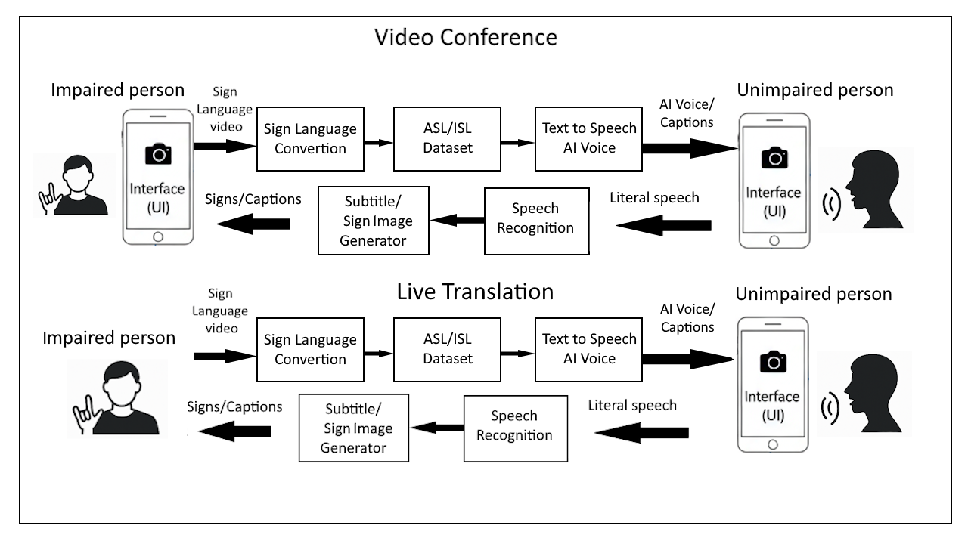
Proposed Solution
Block Diagram

Slide 10
Novelty & Scope
Innovation
Provides real-time, two-way translation between speech and sign language within a single platform.
Integrates AI-powered speech recognition and gesture detection for accurate communication.
Enables natural and inclusive interaction through live video-based communication.

Slide 11
Novelty & Scope
Implementation Scope
Implementation of real-time video communication with integrated speech and sign language translation.
Development of AI-based modules for speech-to-text, text-to-speech, and sign language gesture recognition.
Deployment of a user-friendly and accessible interface supporting live translation in both virtual (video calls) and real-world scenarios.

Slide 12
Novelty & Scope
Advantages
Enables real-time, two-way communication between hearing/speech-impaired and normal users.
Reduces dependence on human interpreters, promoting independent interaction.
Improves accessibility and inclusivity using AI-powered translation and video communication.

Slide 13
Challenges & Risks
Technical challenges and Mitigation plan
1. WebRTC Latency
Challenge: Delay during peer-to-peer communication Solution:
TURN server fallback
Optimized ICE candidate handling
2. ML Performance (Browser)
Challenge: High computation cost Solution:
WebGL acceleration
Frame throttling during inference

Slide 14
3. Model Accuracy
Challenge: Gesture misclassification Solution:
Data augmentation
Confidence thresholds before prediction output

Slide 15
Result
Milestones
Milestone | Description | Status
M1 | System Architecture Finalized | ✅ Completed
M2 | WebRTC Connectivity | ✅ Completed
M3 | Video Call fully implemented | ✅ Completed
M4 | ML Training Pipeline | ✅ Completed
M5 | Supabase Integration | ✅ Completed
M6 | Live Translation Mode | ✅ Completed
M7 | AI Training Mode | ✅ Completed
M8 | Sign Language Training | ✅ Completed
M9 | Final Deployment & APK | ✅ Completed

Slide 16
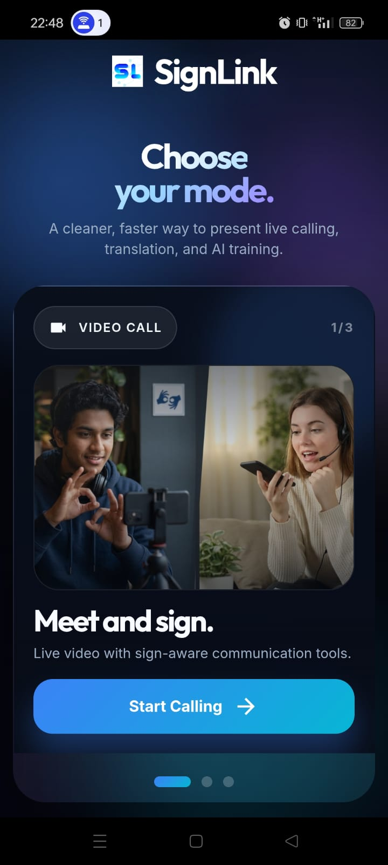
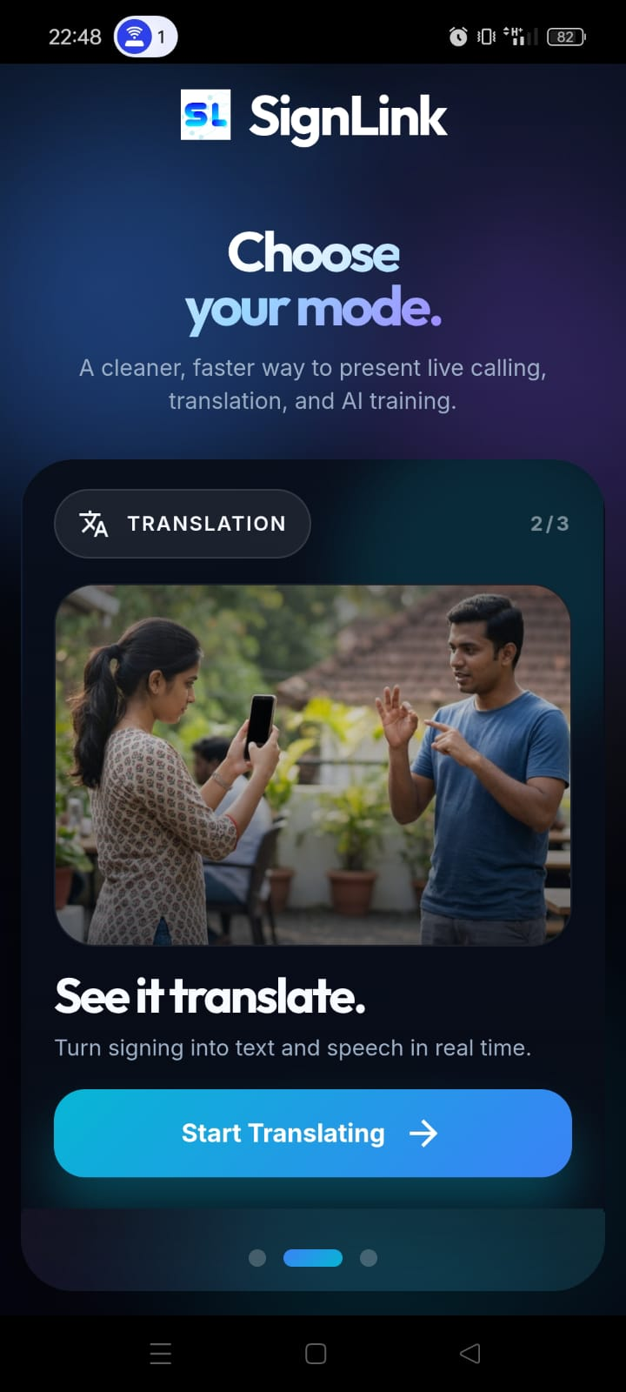
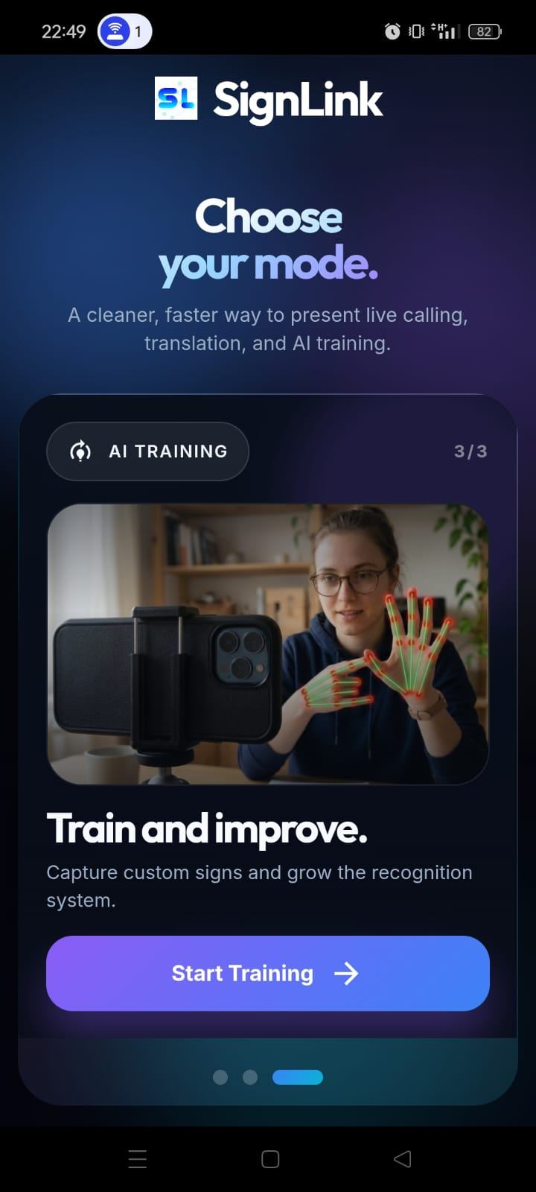
Screenshots

Slide 17
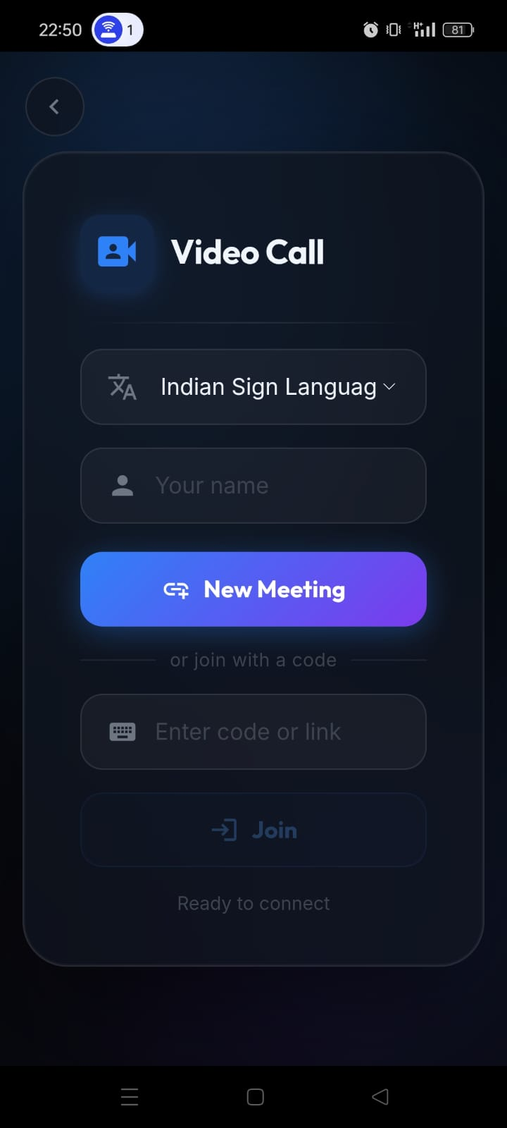
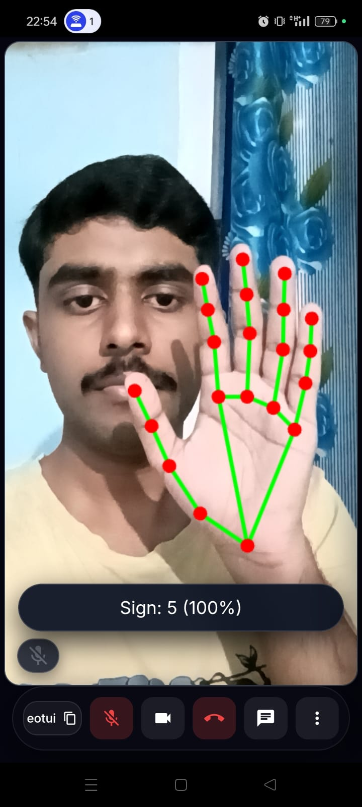
Screenshots

Slide 18
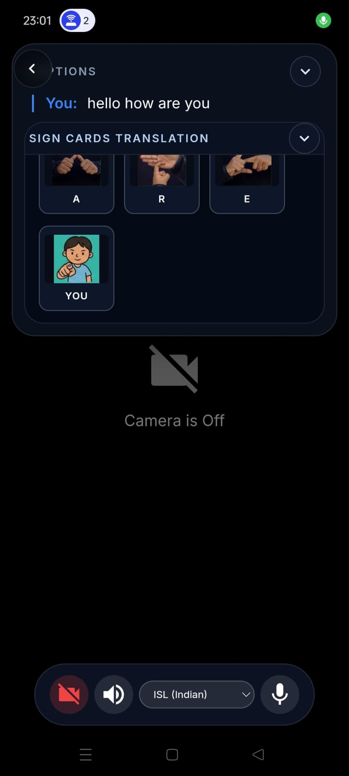
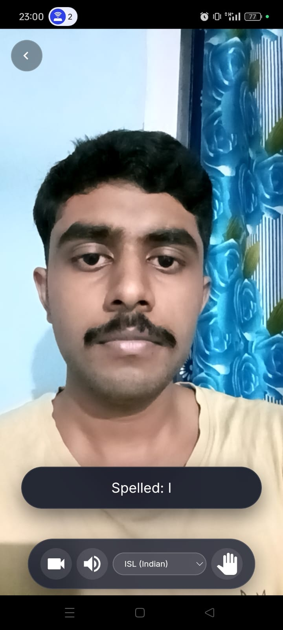
Screenshots

Slide 19
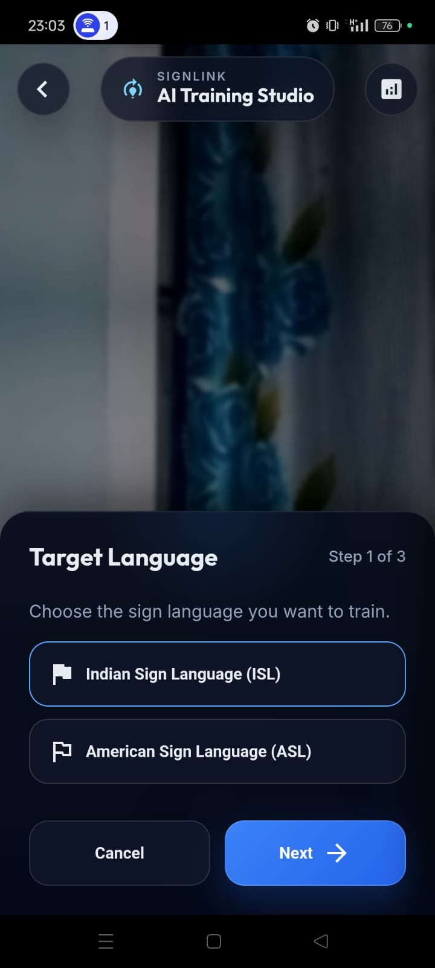
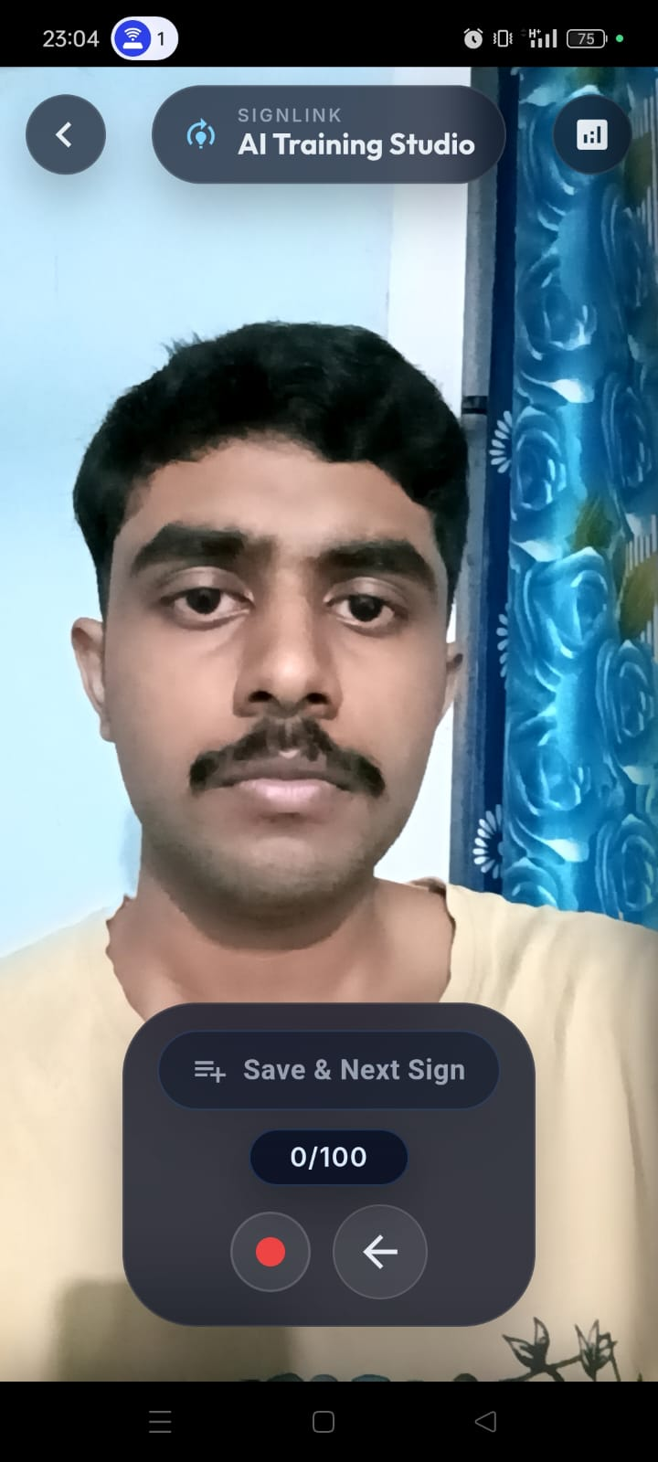
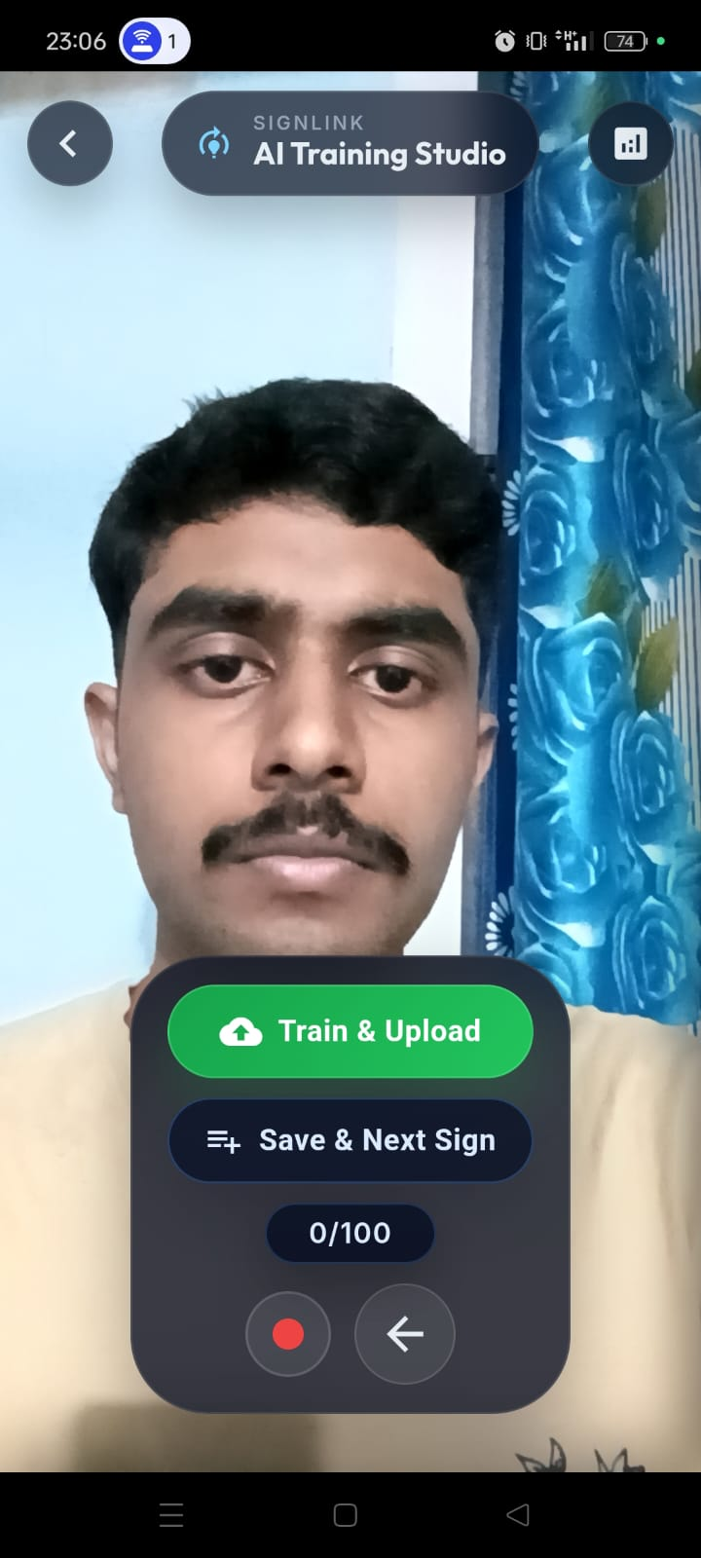
Screenshots

Slide 20
Conclusion & Future Work
Conclusion
SIGN-LINK uses AI to help sign language users communicate with others.
It translates sign language in real time for easier communication.
Computer vision detects hand gestures accurately.
Deep learning improves recognition accuracy.
The system provides fast communication with low delay.
Future improvements in data and models can make the system better.

Slide 21
Conclusion & Future Work
Future Work
Larger ISL datasets
More accurate deep learning models
3D sign language avatars
Multilingual sign language support
Limitations
Requires large training datasets
Performance affected by lighting conditions
Difficulty recognizing complex gestures
Limited support for all regional sign languages

Slide 22
Task Contribution
Team Member Roles and Work Breakdown
1. Shalin Philip
User experience optimization
Live Translation page
Datasets training
Gesture Training
2. M.S Saurav
AI Training page
Capacitor Mobile APK
Capacitor Native STT and TTS
Gesture Training

Slide 23
Task Contribution
3. Eldhose George
WebRTC real-time connectivity
Signaling server (Supabase real-time channel)
TURN/STUN server
MediaPipe Hand Recognition
4. Aanjo Reji Paul
Supabase Integration
Homepage UI
Overall testing

Slide 24
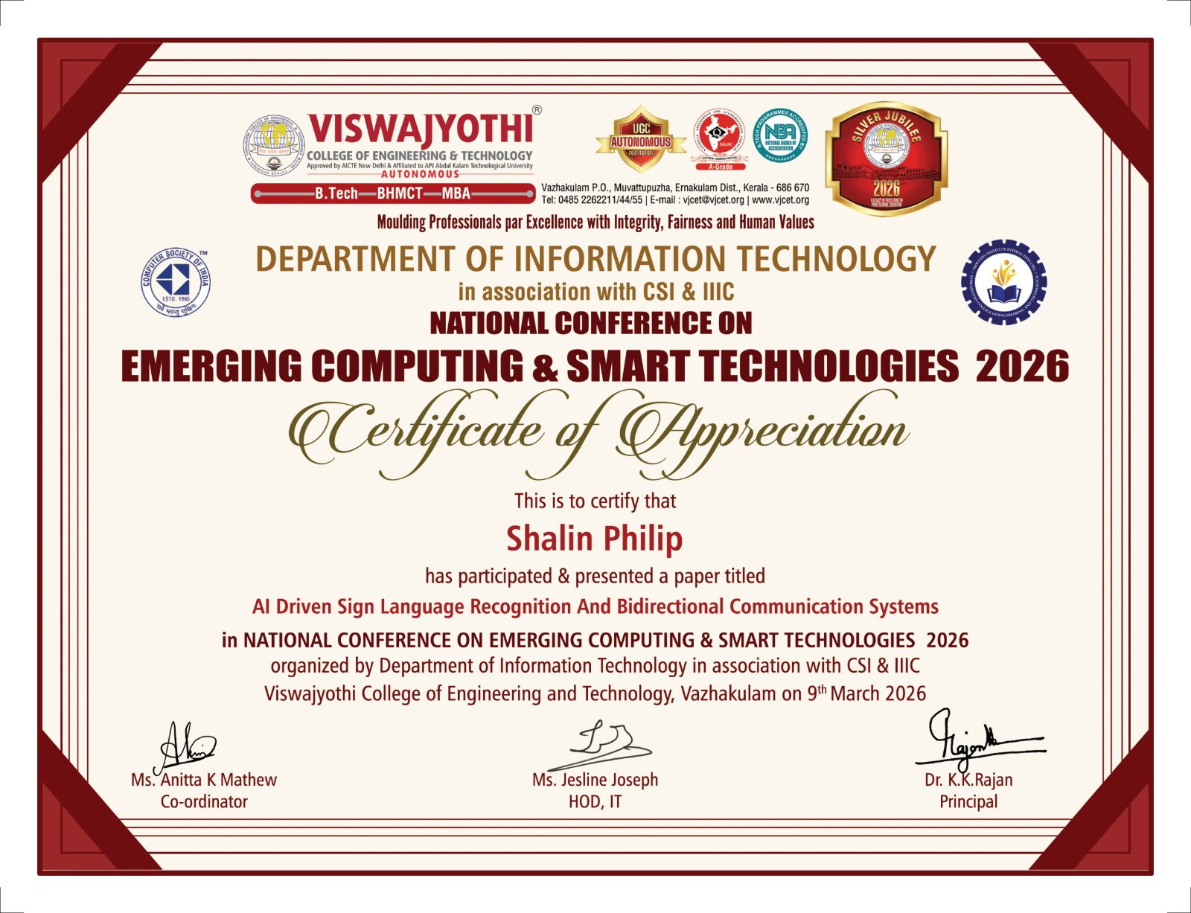
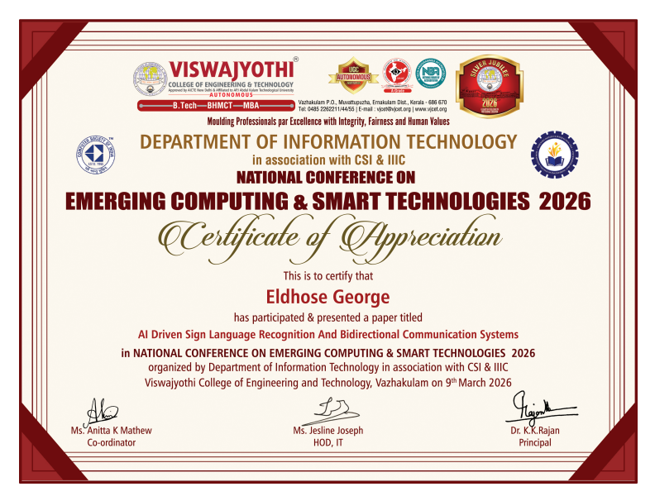
Publication and IPR
Presented paper titled “AI-Driven Sign Language Recognition and Bidirectional Communication System (SIGNLINK)” at National Conference On Emerging Computing & Smart Technologies 2026 at VJCET, Vazhakulam

Slide 25
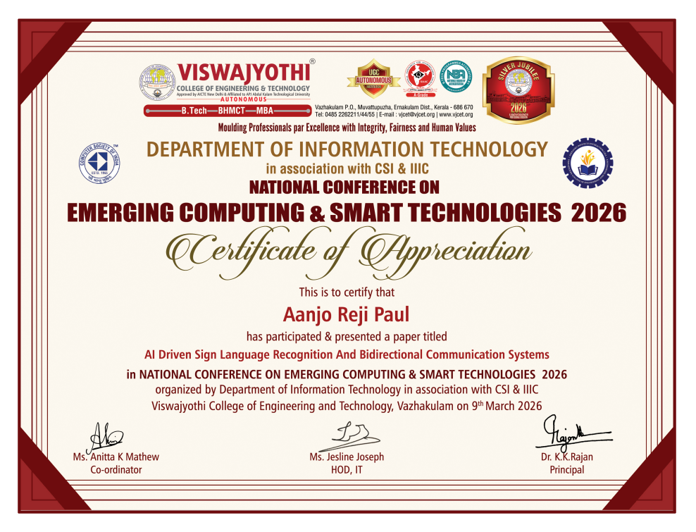
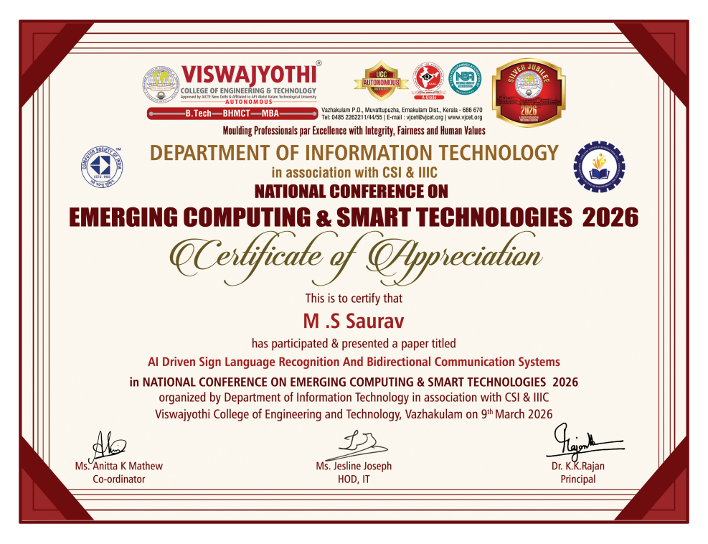
Publication and IPR
Presented paper titled “AI-Driven Sign Language Recognition and Bidirectional Communication System (SIGNLINK)” at National Conference On Emerging Computing & Smart Technologies 2026 at VJCET, Vazhakulam

Slide 26
Thank You

